Slide 1
DOM105 2019
Session 20-21
Reading: Ch. 14.1-14.6

Slide 2
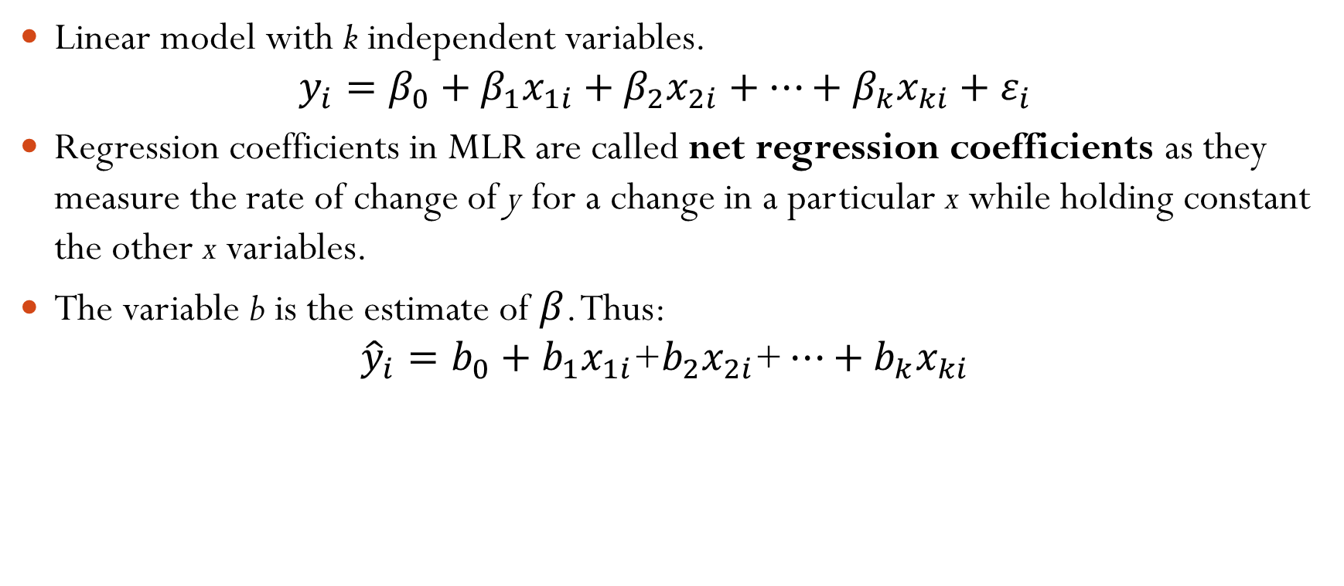
Multiple linear regression model
Linear model with k independent variables.
$$y_{i}=β_{0}+β_{1}x_{1i}+β_{2}x_{2i}+…+β_{k}x_{ki}+ε_{i}$$
Regression coefficients in MLR are called net regression coefficients as they measure the rate of change of y for a change in a particular x while holding constant the other x variables.
The variable b is the estimate of $β$. Thus:
$${\hat{y}}_{i}=b_{0}+b_{1}x_{1i}\text{+}b_{2}x_{2i}\text{+}…+b_{k}x_{ki}$$

Slide 3
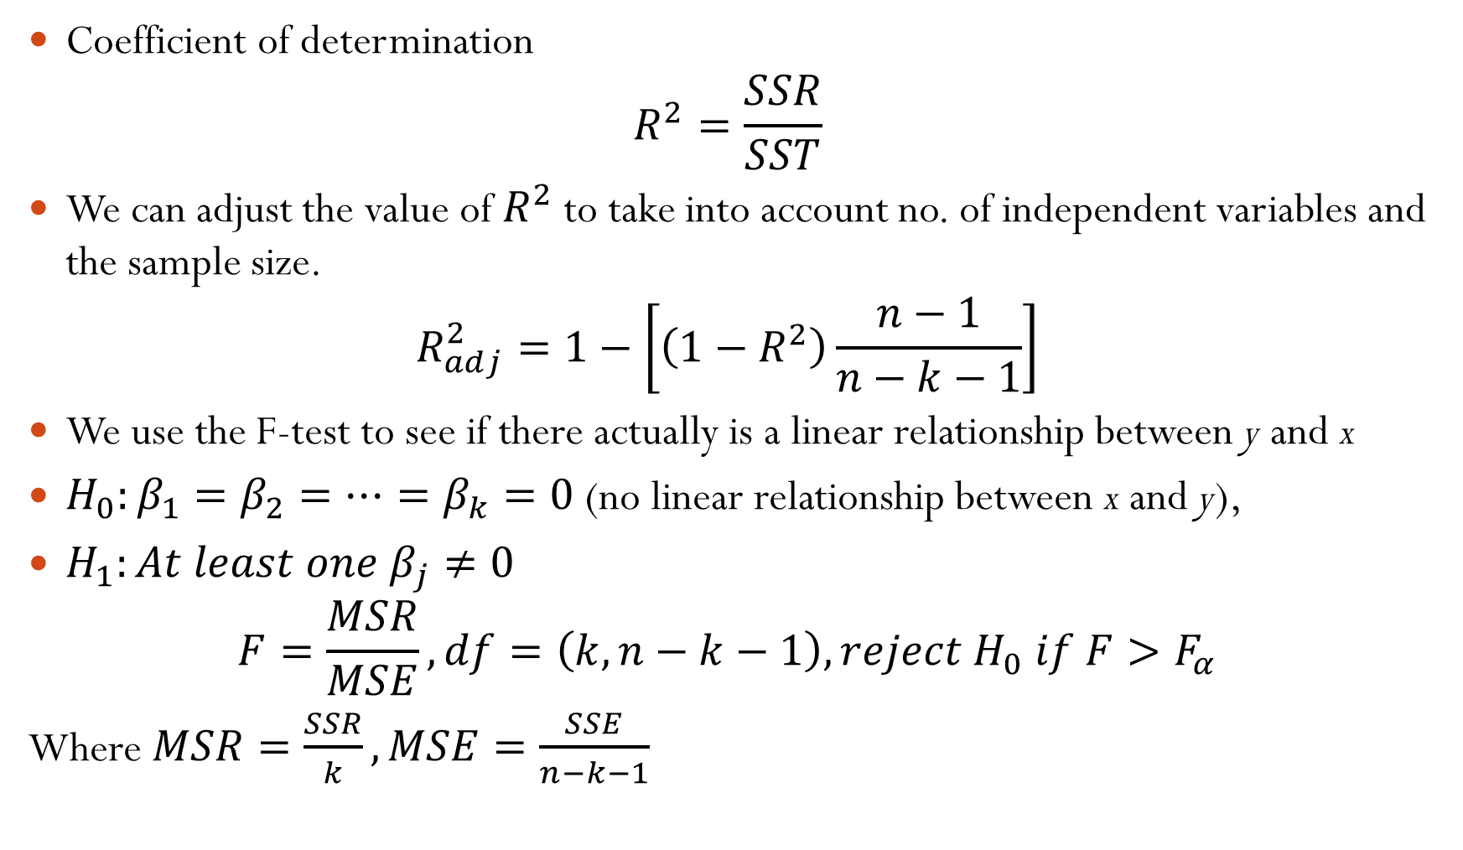
Coefficient of determination
$$R^{2}=\frac{SSR}{SST}$$
We can adjust the value of $R^{2}$ to take into account no. of independent variables and the sample size.
$$R_{adj}^{2}=1−\left[\left(1−R^{2}\right)\frac{n−1}{n−k−1}\right]$$
We use the F-test to see if there actually is a linear relationship between y and x
$H_{0}:β_{1}=β_{2}=…=β_{k}=0$ (no linear relationship between x and y),
$H_{1}:At least one β_{j}≠0$
$$F=\frac{MSR}{MSE}, df=\left(k, n−k−1\right), reject{ H}_{0} if F>F_{α}$$
Where $MSR=\frac{SSR}{k}, MSE=\frac{SSE}{n−k−1}$

Slide 4
Residual testing
Residuals versus predicted value chart, existence of a pattern indicates possible violation of assumption of equal variance
Residuals versus independent variable chart, existence of patterns indicates curvilinear effect in the variable.
Durbin-Watson test for autocorrelation is also used (formula unchanged from Simple Linear Regression)

Slide 5
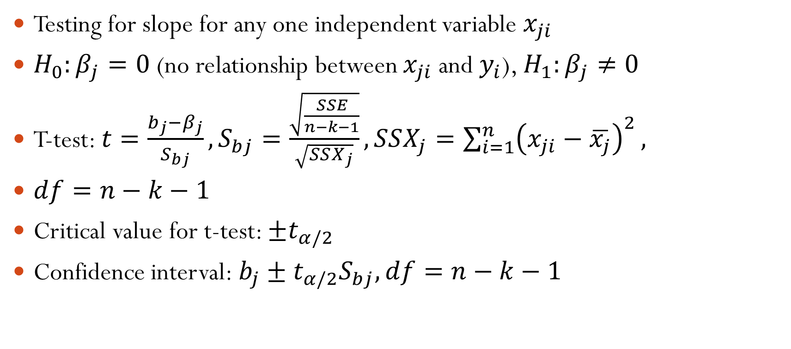
T-test for slope with any one independent variable
Testing for slope for any one independent variable $x_{ji}$
$H_{0}:β_{j}=0$ (no relationship between $x_{ji}$ and $y_{i}$), $H_{1}:β_{j}≠0$
T-test: $t=\frac{b_{j}−β_{j}}{S_{bj}},S_{bj}=\frac{\sqrt{\frac{SSE}{n−k−1}}}{\sqrt{SSX_{j}}},SSX_{j}=\sum_{i=1}^{n}{{\left(x_{ji}−\overline{x_{j}}\right)}^{2}},$
$df=n−k−1$
Critical value for t-test: $±t_{α/2}$
Confidence interval: $b_{j}±t_{α/2}S_{bj}, df=n−k−1$
Notes:
$$does not significantly improve model on inclusion$$
$$H_{1}:Variable x_{j} does significantly improve model on inclusion$$
$$SSR\left(x_{j} | All x except j\right)=SSR−SSR(All x except j)$$
$$F=\frac{SSR\left(x_{j} | All x except j\right)}{MSE}, df=\left(1,n−k−1\right),reject{ H}_{0} if F>F_{α}$$
SSR(All x except j)=Value of SSR after

Slide 6
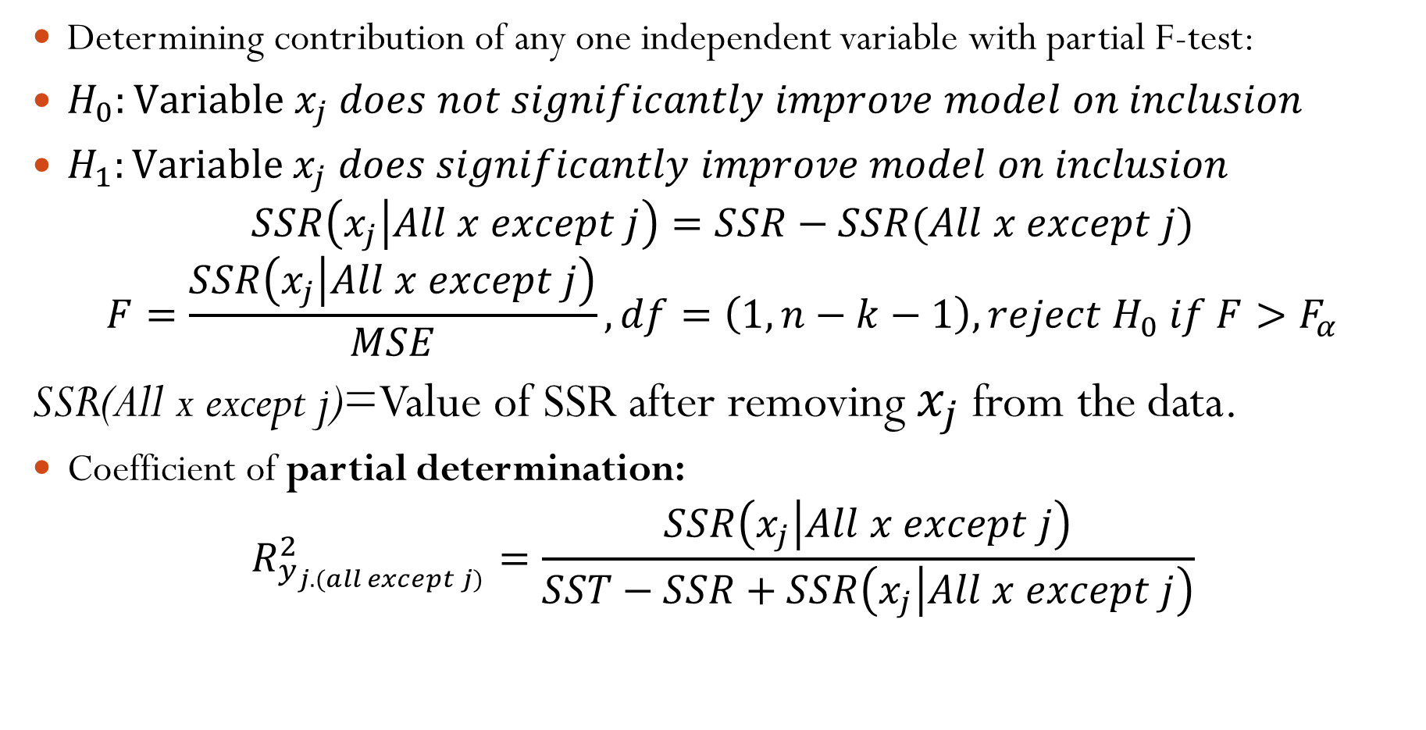
Partial F-test to include new independent variable in existing model
Determining contribution of any one independent variable with partial F-test:
$H_{0}:Variable x_{j} does not significantly improve model on inclusion$
$H_{1}:Variable x_{j} does significantly improve model on inclusion$
$$SSR\left(x_{j} | All x except j\right)=SSR−SSR(All x except j)$$
$$F=\frac{SSR\left(x_{j} | All x except j\right)}{MSE}, df=\left(1,n−k−1\right),reject{ H}_{0} if F>F_{α}$$
SSR(All x except j)=Value of SSR after removing $x_{j}$ from the data.
Coefficient of partial determination:
$$R_{y_{j.(all except j)}}^{2}=\frac{SSR\left(x_{j} | All x except j\right)}{SST−SSR+SSR\left(x_{j} | All x except j\right)}$$

Slide 7
Dummy variables
A dummy variable is can be used to encode a categorical variable into a numerical value of either 0 and 1. A dummy variable is 0 if it does not have a characteristic, and 1 if it does.
Thus, a categorical variable with d categories gives rise to d dummy variables. If there are only 2 categories, then we can use only one dummy, with 0 and 1 representing the two categories.
One can also encode a categorical variable using unique numbers if a data point belongs to only one category (0=category 1, 1= cat. 2, 2=cate. 3, etc.)

Slide 8
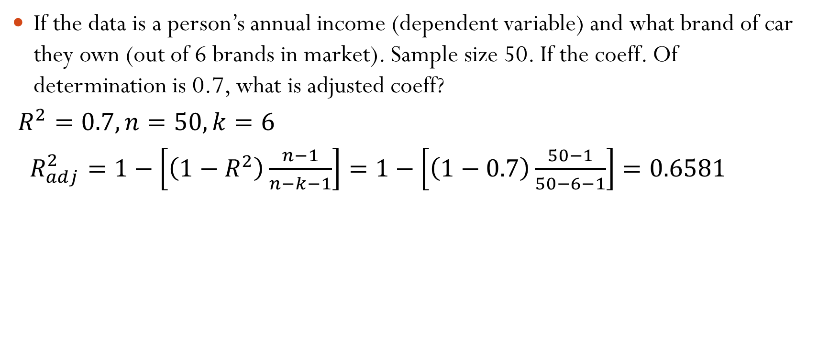
If the data is a person’s annual income (dependent variable) and what brand of car they own (out of 6 brands in market). Sample size 50. If the coeff. Of determination is 0.7, what is adjusted coeff?
$R^{2}=0.7, n=50, k=6$
$R_{adj}^{2}=1−\left[\left(1−R^{2}\right)\frac{n−1}{n−k−1}\right]=1−\left[\left(1−0.7\right)\frac{50−1}{50−6−1}\right]=0.6581$

Slide 9
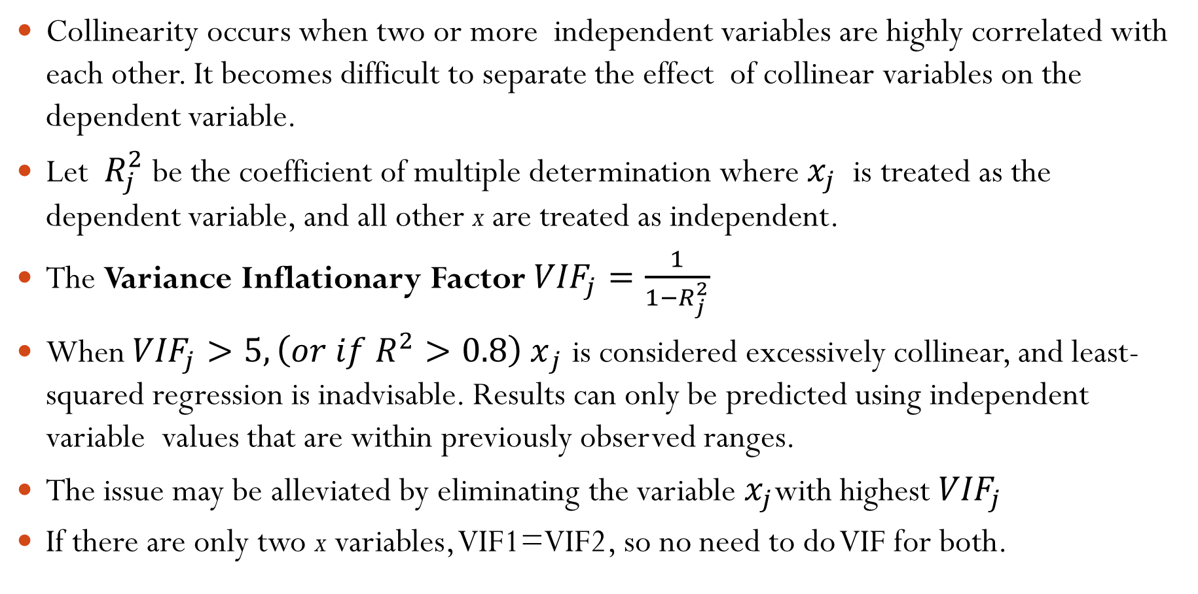
Collinearity
Collinearity occurs when two or more independent variables are highly correlated with each other. It becomes difficult to separate the effect of collinear variables on the dependent variable.
Let $R_{j}^{2}$ be the coefficient of multiple determination where $x_{j}$ is treated as the dependent variable, and all other x are treated as independent.
The Variance Inflationary Factor ${VIF}_{j}=\frac{1}{1−R_{j}^{2}}$
When ${VIF}_{j}>5, {\left(or if R^{2}>0.8\right) x}_{j}$ is considered excessively collinear, and least-squared regression is inadvisable. Results can only be predicted using independent variable values that are within previously observed ranges.
The issue may be alleviated by eliminating the variable $x_{j}$with highest ${VIF}_{j}$
If there are only two x variables, VIF1=VIF2, so no need to do VIF for both.

Slide 10
Model building in MLR – simple method
Perform t-test for slope on remaining independent variables to see if they actually have a slope with y
Check VIF values to eliminate independent variables with high Collinearity
Variables that are left after both tests are used to build the MLR model.
Limitation: this method creates models that are at maximum complexity (every variable that can contribute are included). This is not important when the number of possible variables is small.
Using methods like stepwise regression or best-subsets, it is possible to create smaller models (using fewer variables) that are almost as good a fit as larger ones.

Slide 11
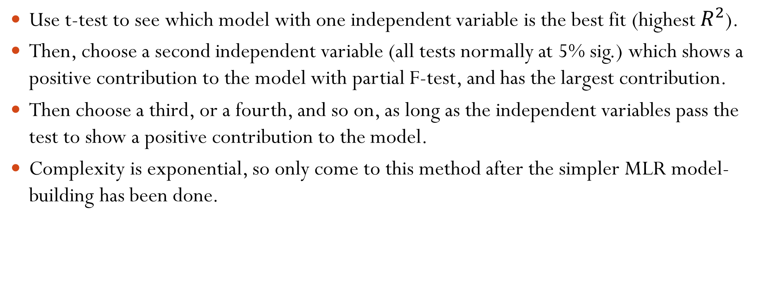
Model building using stepwise regression (not coming in tests)
Use t-test to see which model with one independent variable is the best fit (highest $R^{2}$).
Then, choose a second independent variable (all tests normally at 5% sig.) which shows a positive contribution to the model with partial F-test, and has the largest contribution.
Then choose a third, or a fourth, and so on, as long as the independent variables pass the test to show a positive contribution to the model.
Complexity is exponential, so only come to this method after the simpler MLR model-building has been done.

Slide 12
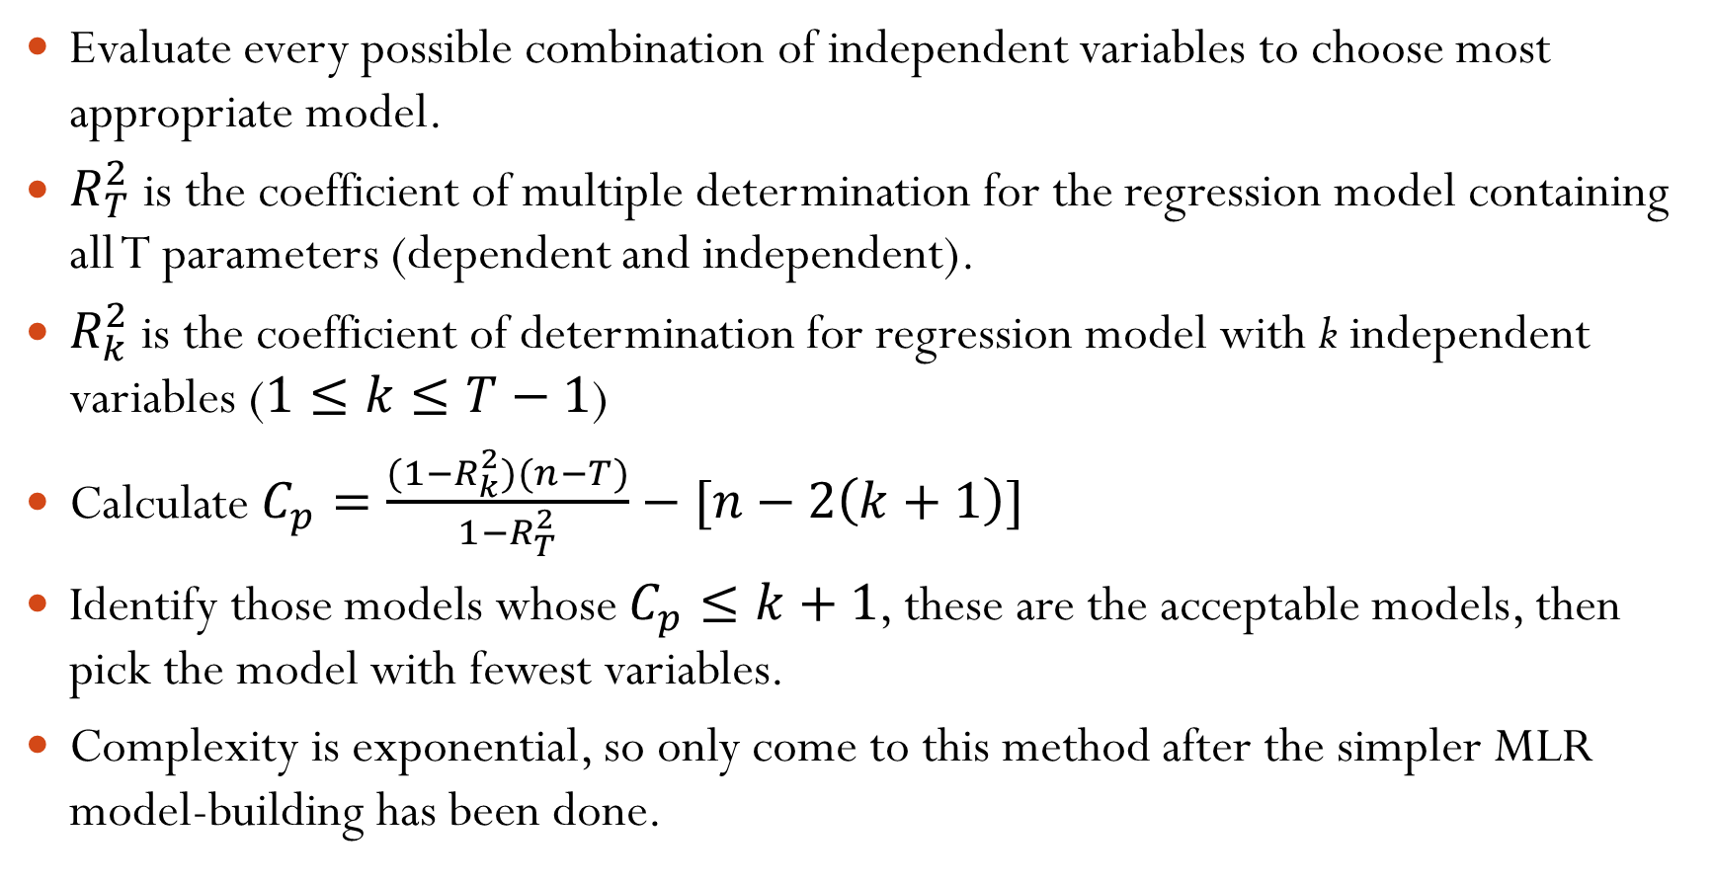
Best-subsets approach to model building (not coming in tests)
Evaluate every possible combination of independent variables to choose most appropriate model.
$R_{T}^{2}$ is the coefficient of multiple determination for the regression model containing all T parameters (dependent and independent).
$R_{k}^{2}$ is the coefficient of determination for regression model with k independent variables ($1≤k≤T−1$)
Calculate $C_{p}=\frac{(1−R_{k}^{2})(n−T)}{1−R_{T}^{2}}−[n−2\left(k+1\right)]$
Identify those models whose $C_{p}≤k+1$, these are the acceptable models, then pick the model with fewest variables.
Complexity is exponential, so only come to this method after the simpler MLR model-building has been done.

Slide 13
Practice and Quiz
Perform VIF and t-test on the practice data Session 20-21 excel, and find the simplest model.
Quiz 2 on Thursday April 4

